Slide 1
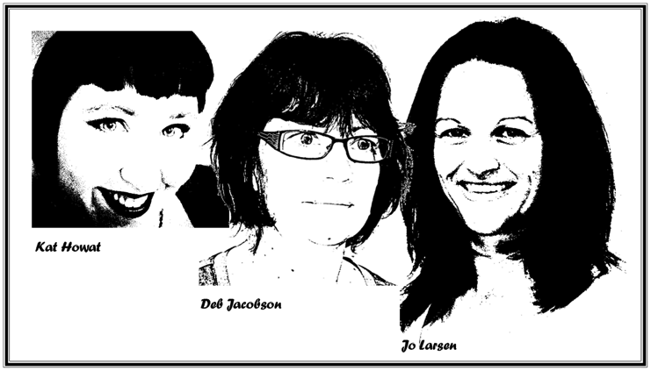
Art Movement Timeline

Slide 2
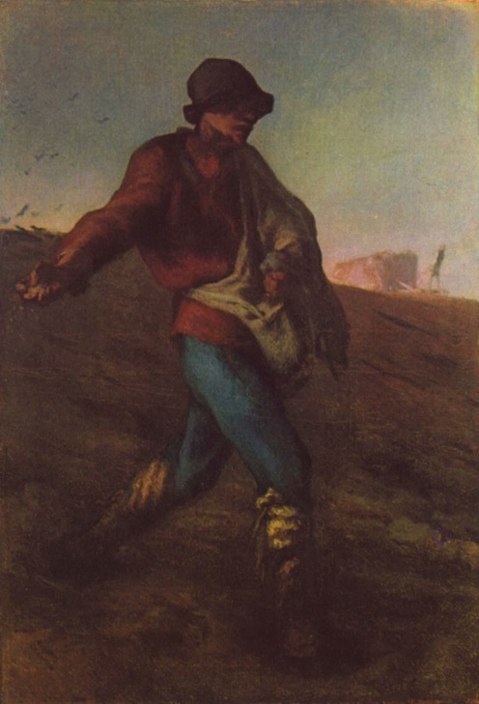
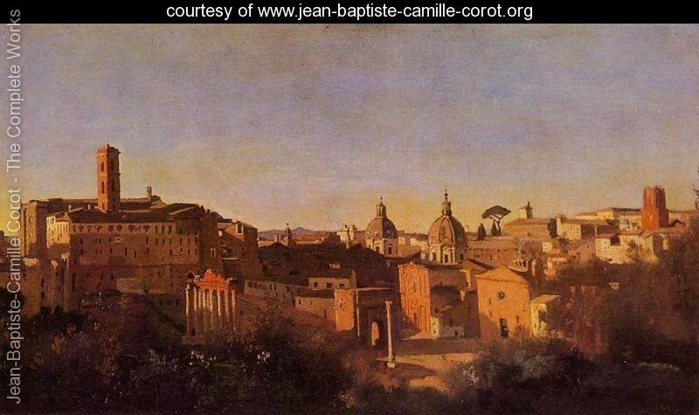
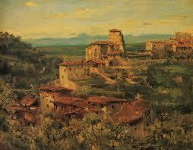
Realism 1965 - 1900
http://artyfactory.com/art_appreciation/timelines/modern_art_timeline_part_2.html
Jean Baptiste Camille Carot Theodore Rousseau Jean Fancious Millet

Slide 3
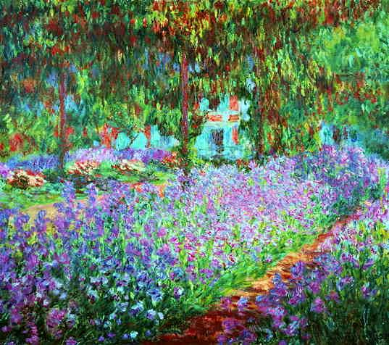
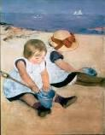
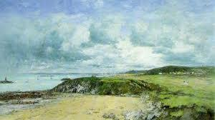
Impressionism 1800 - 1900
http://artyfactory.com/art_appreciation/timelines/modern_art_timeline_part_2.html
Claude Monet Eugene Bouden Mary Cassatt

Slide 4
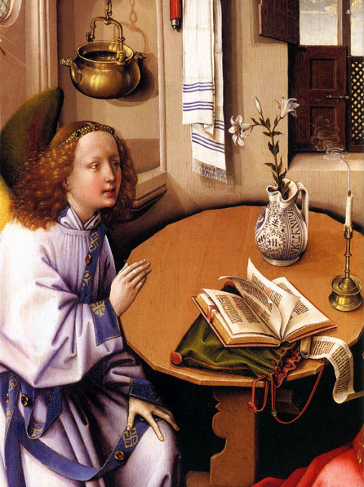
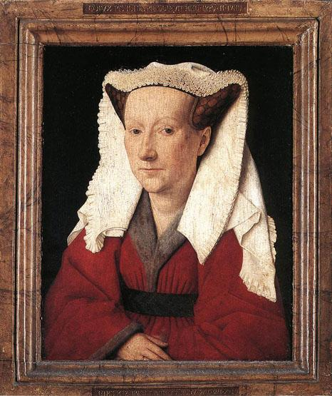
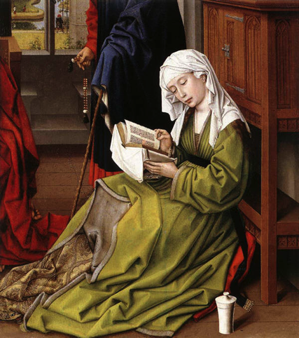
Gothic (1144 – 1500s)
http://artyfactory.com/art_appreciation/timelines/modern_art_timeline_part_2.html
Jan Van Eyck Rogier Van Der Weyden Robert Campin

Slide 5
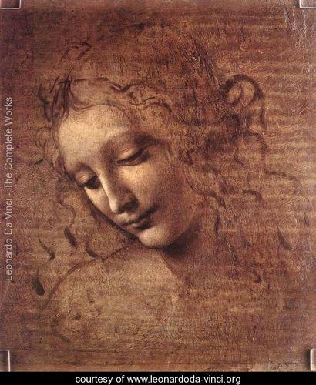
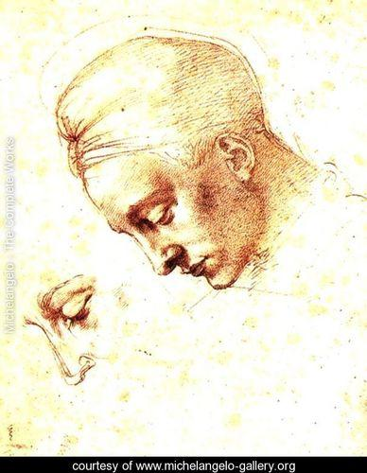
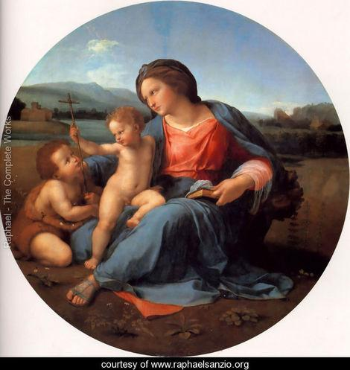
Renaissance (1300 - 1700)
Renaissance is an endeavour to return to the ideas, values and art of the Greek and Roman antique. During this time period, the art movement was dominated by three artists:
Leonardo da Vinci (1452-1519) Michelangelo Buonarroti (1475-1564) Raphael Sanzio (1483-1520)

Slide 6
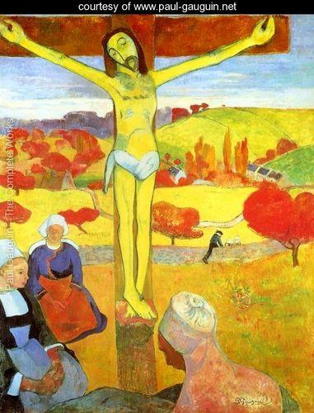
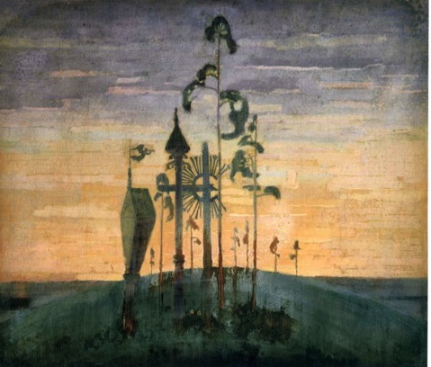
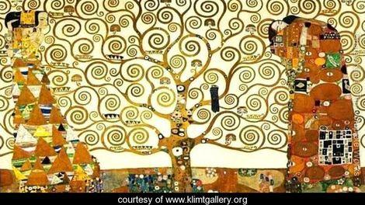
Symbolism (1870 - )
Symbolism The term Symbolism means the
systematic use of symbols or pictorial conventions
to express a metaphorical meaning.
Paul Gauguin (1848 -1903) Gustav Klimt (1862-1918) Mikalojus Konstantinas Čiurlionis (1875–1911)

Slide 7
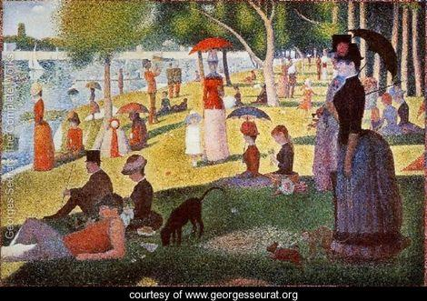
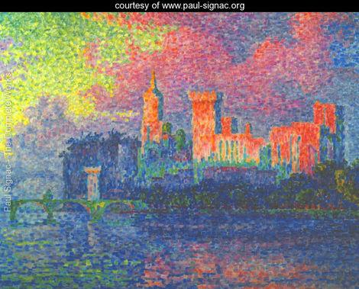
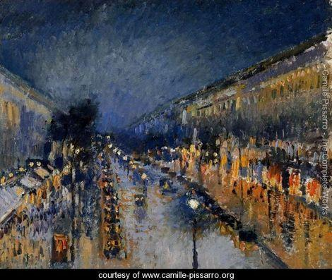
Pointillism (1886 - 1906)
Pointillism is a technique of painting in which small, distinct dots
of pure colour are applied in patterns to form an image
Georges Seurat (1859-1891) Paul Signac (1863-1935) Camille Pissarro (1830-1903)

Slide 8
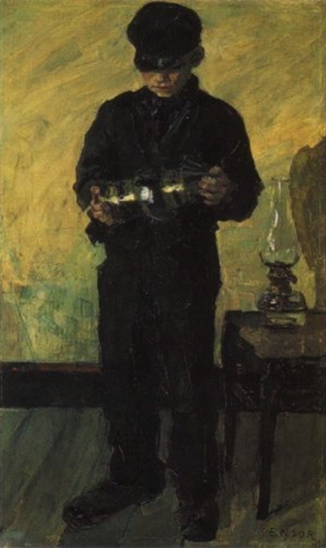
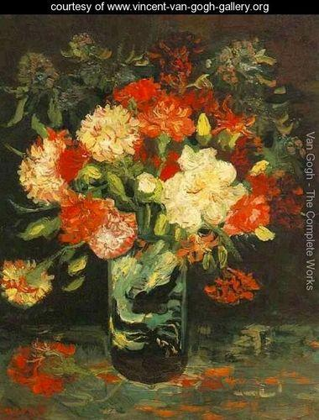
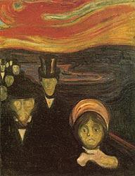
Expressionism (1900 - 1935 )
Expressionism is art that is more associated with emotion or feeling than with literal interpretation of a subject. Expressionistic art uses vivid colours, distortion, two-dimensional subjects that lack perspective. It’s created to express the emotions of the artists as well as produce an emotional response of the viewer.
Edvard Munch (1863-1944) James Ensor (1860-1949) Vincent van Gogh (1853 -1890)

Slide 9
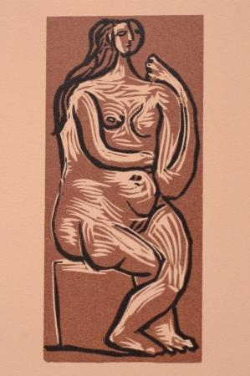
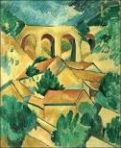
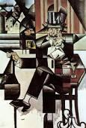
Cubism 1906 - 1919
http://artyfactory.com/art_appreciation/timelines/modern_art_timeline_part_2.html
Pablo Picasso George Braque Juan Gris

Slide 10
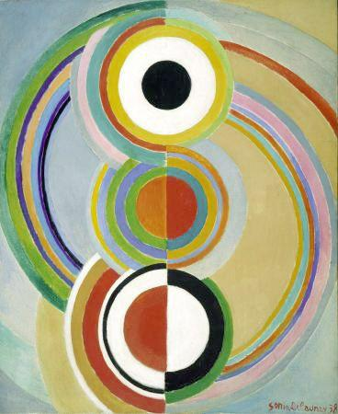
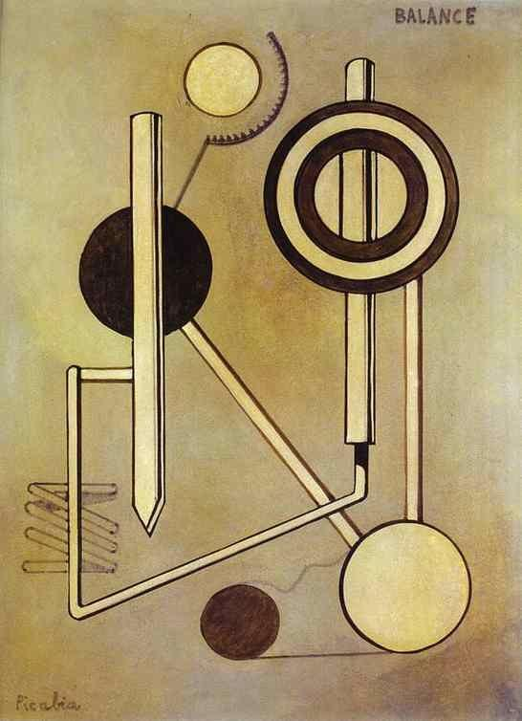
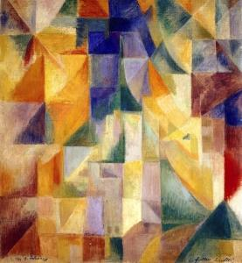
Orphism (1911 - 1914)
Orphism is an artistic trend derived from Cubist painting that gave priority to colour. The movement was named in 1912 by the French poet Guillaume Apollinaire.
Robert Delaunay (1885-1941) Sonia Delaunay (1885-1979) Francis Picabia (1879-1953)

Slide 11
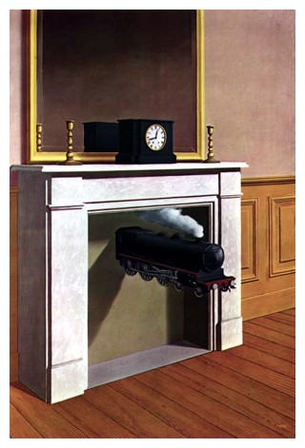
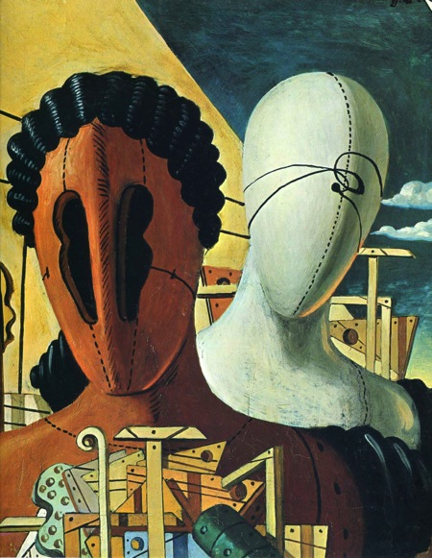
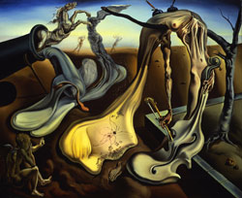
Surrealism (1924 – 1939)
http://artyfactory.com/art_appreciation/timelines/modern_art_timeline_part_2.html
Rene Margritte Salvador Dali Giorgio de Chirico

Slide 12
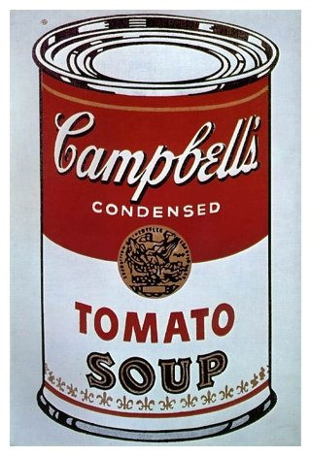
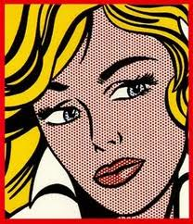
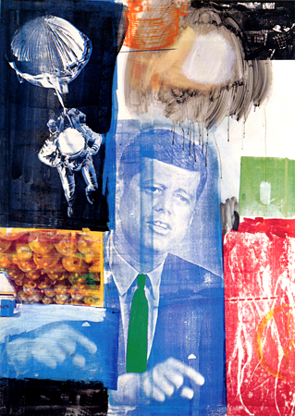
Pop Art (1954 – 1970)
http://artyfactory.com/art_appreciation/timelines/modern_art_timeline_part_2.html
Andy Warhol Roy Lichtenstein Robert Rauschenberg

